Slide 1
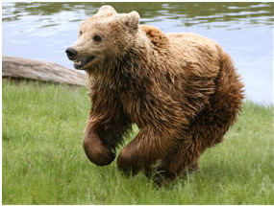
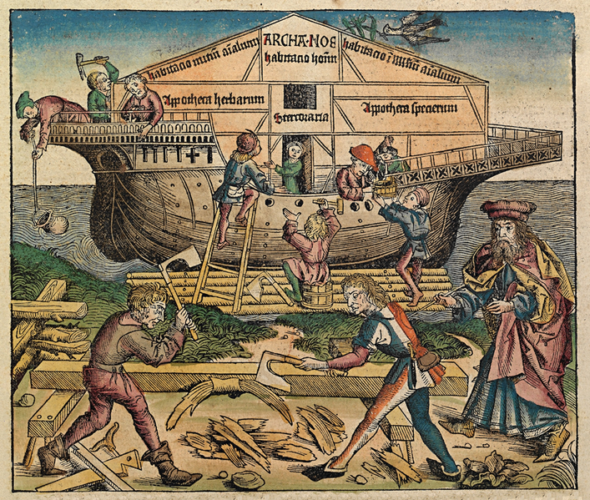
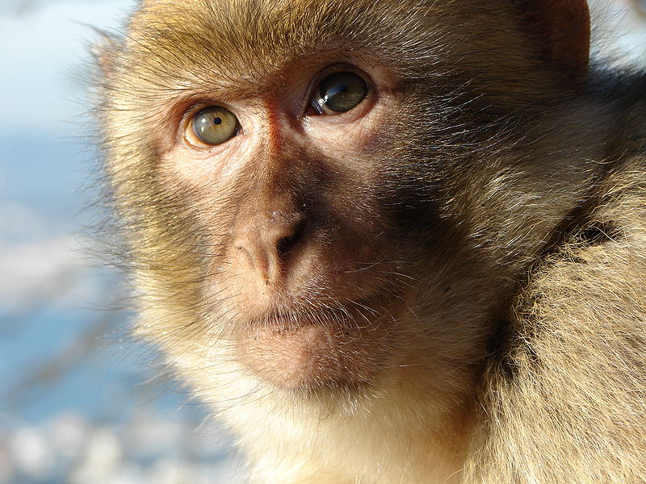
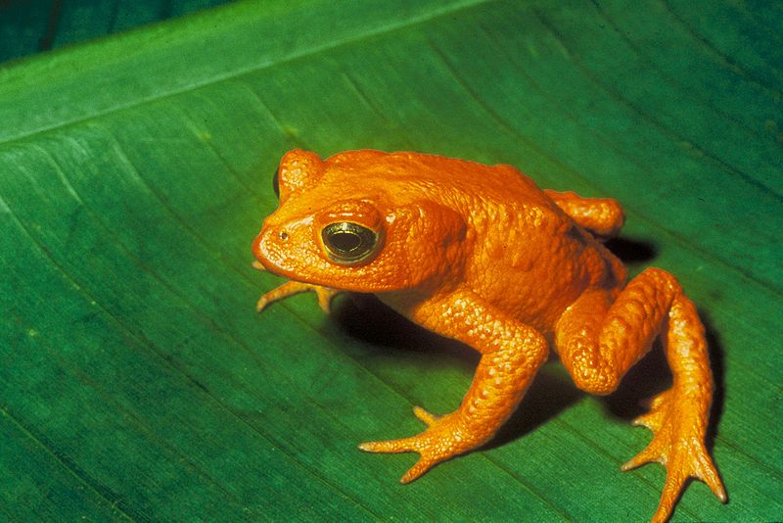
Is this too unbelievable to be true?
A few thousand years ago, the Bible tells us, the people of Earth had become greedy, evil and sinful.
God felt the only solution was to send a flood to wipe them out.
But there was one man, a farmer called Noah, who was a good man.
God told Noah that he and his family would be saved. So Noah built a gigantic vessel, big enough to carry him, his family and two of every kind of animal in the world.

Slide 2
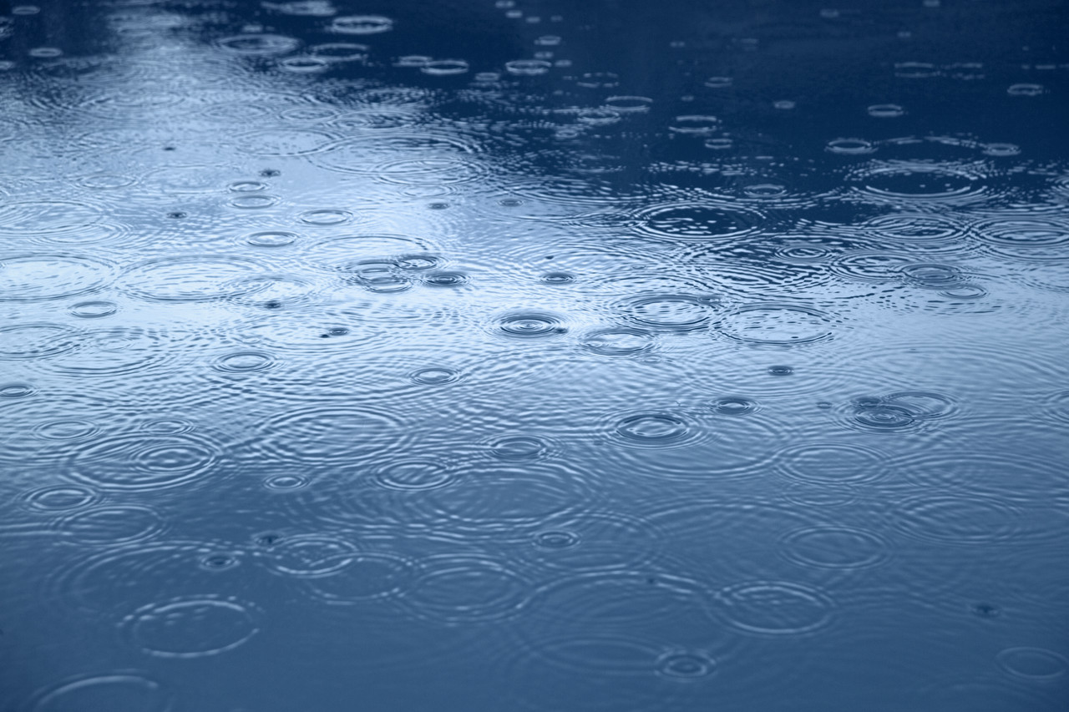
As the rain began to fall, they hurried aboard. The puddles became a flood and the ark lifted off the ground. After forty days of rain there was no dry land to be seen anywhere. The flood lasted for more than a year and for all that time, the ark and its extraordinary cargo stayed afloat.
The Noah's ark story, if it's true, is amazing. But is it true? What do you think?

Slide 3

Here are the questions we came up with.
Could you really have a boat that’s big enough to take two of every kind of animal
Are we meant to believe it happened or is it just a story?
Was there a flood and did it actually cover the whole Earth?

Slide 4
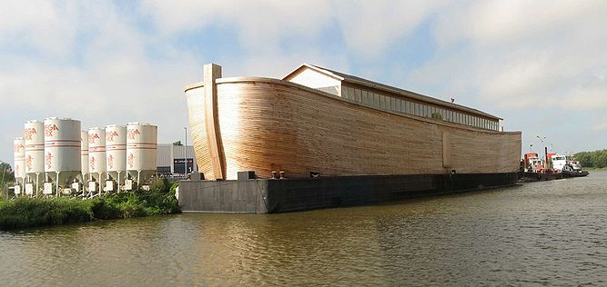
According to the Bible, the ark was HUGE. The boat in the photo above is a half-length model. The ark was as long as six tennis courts and three stories high.
So If it existed, it looked nothing like this!

Slide 5
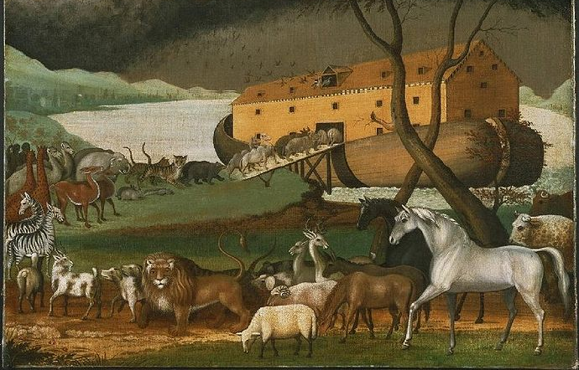

There is disagreement about how many animals boarded the ark. The idea was that contained two of each of the animals that live on the land.
Some say that means it needed to carry an impossible two million pairs of animals. Others say that the ark only needed to carry 50,000 animals, and that there was plenty of space for all.
All aboard!
Giraffes, elephants, cats and dogs ... But no need for any fish, because they could swim!
A painting by the American Edward Hicks (1780 - 1849), showing the animals boarding Noah's Ark two by two from http://en.wikipedia.org/wiki/File:Noahs_Ark.jpg

Slide 6
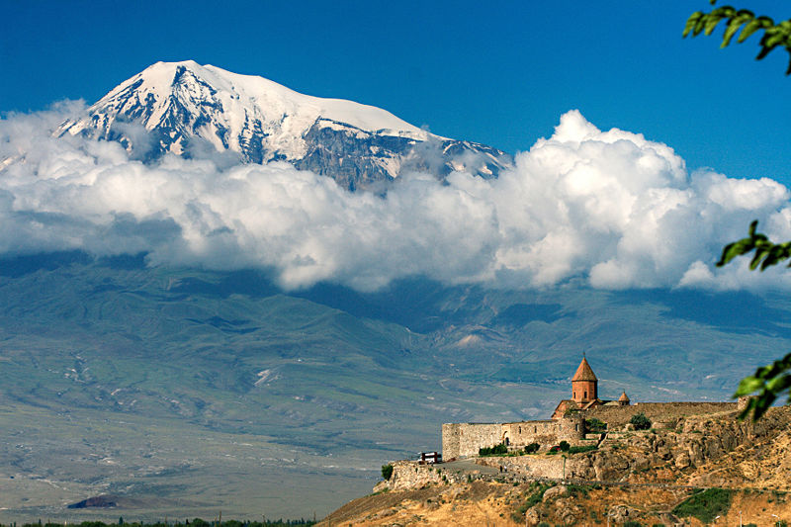
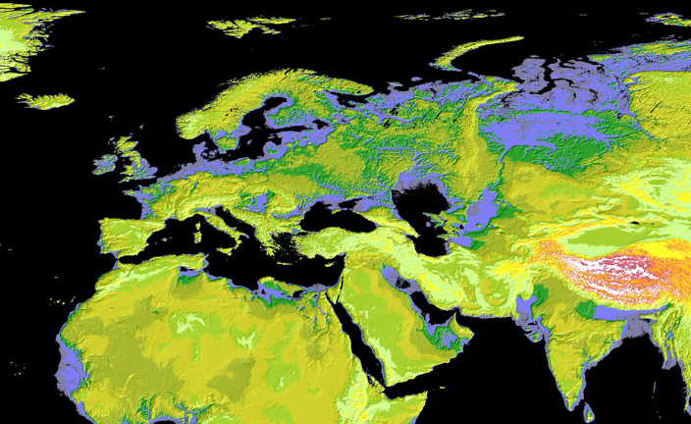
Hunting for evidence
This pic from http://en.wikipedia.org/wiki/File:Kohrvirab.jpg
Genesis 8:4 says the Ark came to rest on a mountain, thought to be Ararat in Turkey. Archaeologists and geologists have hunted for evidence that the flood took place. Most think a local flood may well have happened, but not a flood that covered the Earth. Mind you, a local flood back then may have seemed to cover the Earth.

Slide 7
But if the text isn’t meant to be read literally, why is it there? What does the story of Noah’s ark say about God and his relationship with the people in His world? Why did the writers of this story think it needed to be shared? On the next page is a version of the story, see what it tells us.
Painting showing construction of the Ark (1493) from http://en.wikipedia.org/wiki/File:Nuremberg_chronicles_f_11r_1.png

Slide 8
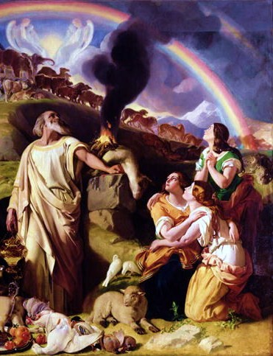
The Noah’s ark story
A few generations after Adam and Eve, God despaired of the people of Earth. They were violent and corrupt. God announced He would wipe out the entire population and begin afresh. One man, however, was honest and blameless and that man was Noah. God told Noah that he and his family would be saved. He instructed Noah to build an ark, a huge vessel that can hold two of every kind of animal.
It took months of hard work, but at last the ark was finished. The animals were still climbing aboard as the rains began to fall. Never before and never again has so much rain fallen from the sky. By the time it stopped, even the mountain tops were covered. It took almost a year for the flood water to drain away, but at last, Noah removed the covering of the ark and saw that the land was dry.
Noah presented a sacrifice to God and God told him that from then on, he and his descendants could kill animals to eat meat but must drain the meat of blood. God promised that He would never again destroy the Earth by water. The promise was marked across the sky with a rainbow.
Noah's sacrifice from http://en.wikipedia.org/wiki/File:NoahsSacrifice.JPG

Slide 9
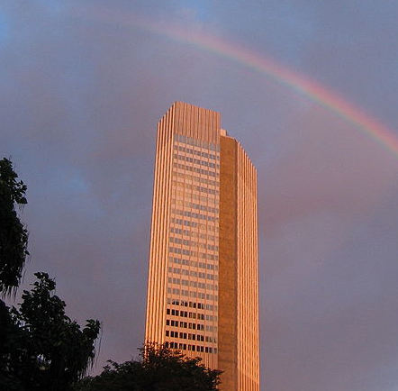
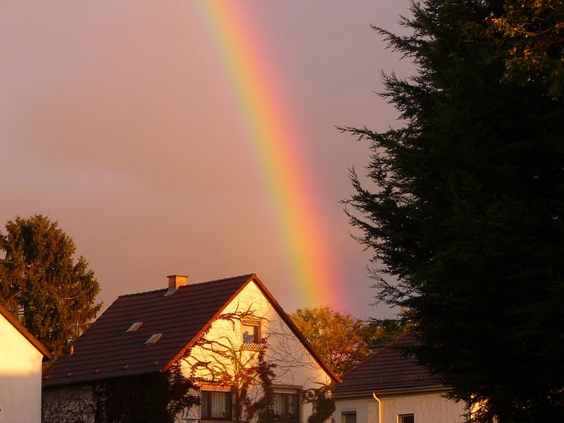
Here are some ideas about what the story might be telling us. Which do you think about these ideas?
Noah was a good man. God notices the good people among us and values their efforts.
Until this time, God was very direct with the Hebrew people - punishing them when they disobeyed Him. But from this time on, the relationship changes. God tells us that from here on we must take responsibility for maintaining standards of good behaviour.
The ark represents a place of worship. Those who come to God and worship him can expect to be saved and have eternal life.
What does Noah’s ark mean for people today?
What does it mean for you?
Photos from wikimedia.

Slide 10
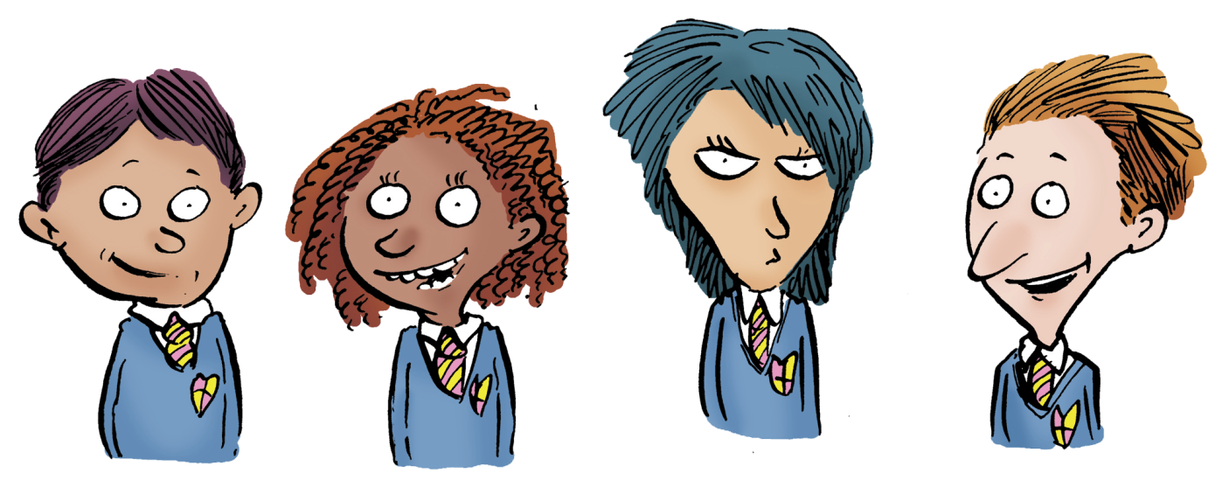
What do you think now?
Was there a flood and did it actually cover the whole Earth?
Could you really have a boat that’s big enough to take two of every kind of animal
Are we meant to believe it happened or is it just a story?

