Slide 1
Mary Anning
Fossil hunter 1799 - 1847

Slide 2
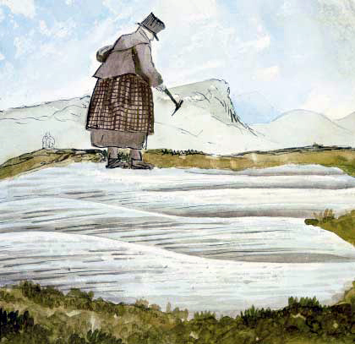
Who is Mary Anning?
Notes:
Mary Anning began collecting and selling fossils at a young age with her family, on the beaches near her home.

Slide 3
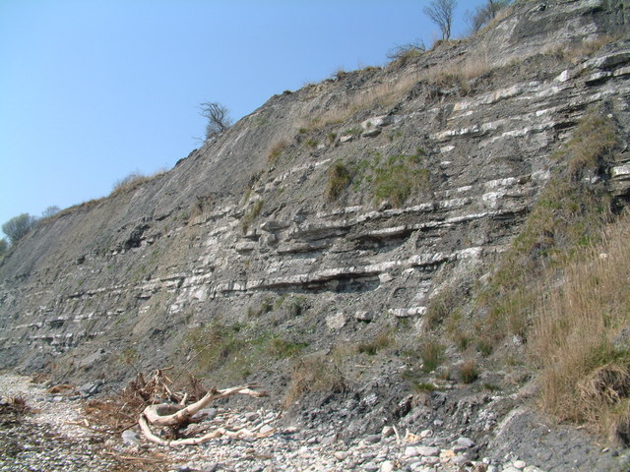
Lyme Regis
Notes:
Lyme Regis was an excellent spot to hunt fossils. Roughly 200 million years ago, the area lay near the equator, at the bottom of a tropical sea. This is due to land movements over very very long timespans. Fossils formed here because marine animals were often quickly buried in sea-floor mud and preserved. Now, Lyme Regis is a beach with cliffs found bordering the counties Devon and Dorset that has lots of fossils just waiting to be found. Today, people are allowed to collect fossils from loose rocks along the beach. People are also allowed to dig along the cliffs, although only with a permit.

Slide 4
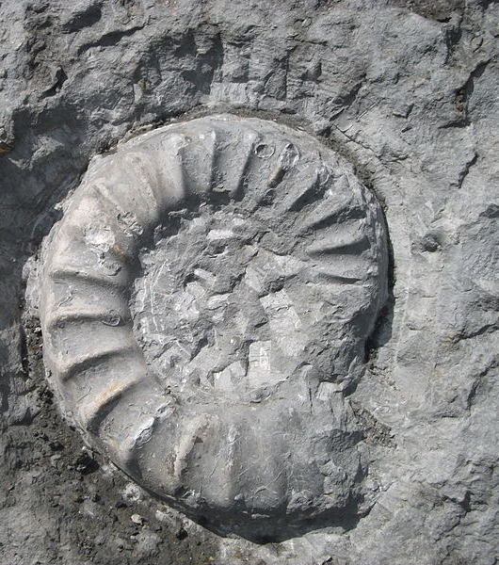
Anning’s ‘Curiosities
In those days they were called:
Vertiberries
Snakestones
Ladies’ fingers
Devils Toenails
Notes:
They weren’t called fossils in those days. They had all sorts of names like vertiberries, snake stones, ladies' fingers devil's toenails. While still a child, Mary called them ‘curiosities’. Which name do you think fits best?

Slide 5
Fossil Hunting for money
She occasionally sold her fossils for between 100-200 pounds which today equates to … Over £150 000!
Notes:
Actually, Mary’s whole family would go fossil hunting but Mary was particularly good at it and loved finding new fossils on her own. They would find fossils to make a living. She occasionally sold fossils for quite a lot of money in those days. Now this may seem like she must have been a very wealthy woman. But she often fell on hard times, sometimes because she couldn't find fossils, and sometimes because the public took no interest in what she did find.
She also had the misfortune of investing a lot of her money and then the man she gave the money to mysteriously disappeared!

Slide 6
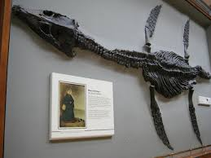
What did Mary find?
Notes:
Mary found all sorts of different fossils, small and big. This is one of her most famous findings – the plesiosaur.

Slide 7
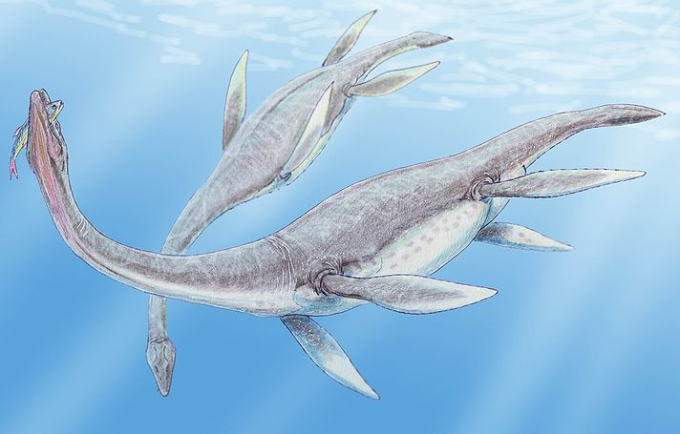
What did Mary find?
Notes:
The Plesiosaurus is also called – the sea dragon. Loch Ness monster anyone?

Slide 8
How Mary got the fossils
Notes:
Mary would walk along the cliffs of lyme regis looking for fossils with her trusty dog, Tray. When Mary found a fossil that she would dig out, she got Tray to stay by the fossil so she could hurry back and get her tools and then find the fossil again. She did this for many years until one day Tray was waiting for Mary beside a fossil when there was a landslide, luckily Mary escaped but sadly her dog didn’t.

Slide 9
Mary’s faith
Mary was deeply religious. She was Anglican, that is she was a Christian of the Church of England. When she had moments of danger she was known to spend more time thinking about God.
Notes:
Mary was deeply religious. She was Anglican which means she was a Christian in the Church of England. During her times fossil hunting she was nearly crushed by a runaway cart, and had many near misses with landslides.
When she had close encounters she was known to spend more time reading the bible in her spare time. She found these moments particularly important and felt she needed to share it with God.

Slide 10
Why few women?
In those times, there were very few women in science. – and women’s contributions were hardly ever reported. We know that girls are as smart as boys!
Notes:
Mary grew up learning to read and write thanks largely to her Sunday school lessons. Other scientists felt that Mary could only have had her skills and knowledge as a gift from God when as a little girl she was struck by lightning.

Slide 11
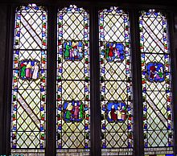
Stain glass window
The Vicar from the local Church and some members of the Geological Society of London made a stain glass window to celebrate her expertise in furthering the science of geology.
Notes:
This window was put up in the local church by the vicar and some members of the Geological Society of London in commemoration of her usefulness in furthering the science of geology, and also of her compassion, heart and integrity of life.

Slide 12
Pop quiz
True or False:
Mary was a scientist who loved studying fossils?
True or False: Mary embraced her passion for science as well as her religious beliefs?
Where in the country were the rocks she went fossil hunting for?
What was her dog’s name?
Mary was nearly crushed by a runaway what?

Slide 13
Pop Quiz
How much money did Mary get for selling some of her fossils?
What year was Mary Anning born?
What was the name of the famous fossil Mary found?
What was Lyme Regis near to 200 million years ago?
List 3 of the nicknames for fossils.

Slide 14
Pop Quiz
What was Mary’s religion?
What was the society that put a window up in memory of Mary?
Where was the window placed?
Who else helped put the window up?

Slide 15
Answers!
Notes:
Mary Anning Quiz Answers
True or False: Mary was a scientist who loved studying fossils?
True
True or False: Mary happily lived her life embracing her passion for science as well as her religious beliefs?
True
Where in the country were the rocks she went fossil hunting for?
Lyme Regis (Half Mark for Dorset or Devon)
What was her dog’s name?
Tray
Mary was nearly crushed by a runaway what?
Cart (No marks for landslide)
How much money did Mary get for selling some of her fossils?
£100-200 OR Over £150,000
What year was Mary Anning born?
1799
What was the name of the famous fossil Mary found?
Plesiosaur OR Sea Dragon
What was Lyme Regis near to 200 million years ago?
The equator
List 3 of the nicknames for fossils. (1=zero marks, 2= half mark)
Curiosities, vertiberries, snakestones, ladies fingers, devils toenails.
What was Mary’s religion?
Anglican OR Christian
What was the society that put a window up in memory of Mary?
The Geological Society of London
Where was the window placed?
Local Church
Who else helped put the window up?
The local Vicar

Slide 16
She sells seashells on the seashore The shells she sells are seashells, I’m sure So if she sells seashells on the seashore Then I’m sure she sells seashore shells
Notes:
This tongue twister is thought to be about Mary Anning, who can say it the fastest?

